Slide 1
Positive Behaviour Supports
Defining Behaviours

Slide 2
Prioritizing & Defining
Determine level 1, 2 or 3
Define behaviour:
Observable
Measurable
Concrete
No inferences

Slide 3
Defining a behaviour
Tantrums
Screaming
Falling on the floor
Disruption
Self-abuse
Pinching others
Aggressive
Grabbing things

Slide 4
Defining a behaviour
Tantrums 
Screaming √
Falling on the floor √
Disruption 
Self-abuse 
Pinching others √
Aggressive 
Grabbing things √

Slide 5
A-B-C
Antecedent, behaviour, consequence
Antecedent: what comes before, the “trigger”
Behaviour: what the student does
Consequence: what follows a behaviour
Basic behavioural sequence; identifies patterns between the variables

Slide 6
A-B-C
James is a seventh-grade student with difficulties in oral reading. In social studies class, each student is expected to take a turn reading part of the chapter out loud. When it is James’s turn, he responds by throwing his books on the floor and swearing at the teacher. His teacher responds by sending him to the vice-principal’s office. This behaviour continues and worsens over the Fall.

Slide 7
A-B-C
James is a seventh-grade student with difficulties in oral reading. In social studies class, each student is expected to take a turn reading part of the chapter out loud. When it is James’s turn, he responds by throwing his books on the floor and swearing at the teacher. His teacher responds by sending him to the vice-principal’s office. This behaviour continues and worsens over the Fall.

Slide 8
A-B-C
Michael, a second-grade student, pushes the other children in line when he is told to stand at the end of the line. When the teacher lets him hold the door, he stops pushing. This happens every time the students line up for lunch. This behaviour continues on a daily basis.

Slide 9
A-B-C
Michael, a second-grade student, pushes the other children in line when he is told to stand at the end of the line. When the teacher lets him hold the door, he stops pushing. This happens every time the students line up for lunch. This behaviour continues on a daily basis.

Slide 10
A-B-C
Jacob is outside at recess. The playground supervisor reminds him to stay in the area dedicated to older students. He yells “You are not the boss of me” at the supervisor and pushes another student out of his way. The supervisor gives him an angry glare.

Slide 11
A-B-C
Jacob is outside at recess. The playground supervisor reminds him to stay in the area dedicated to older students. He yells “You are not the boss of me” at the supervisor and pushes another student out of his way. The supervisor gives him an angry glare.

Slide 12
A-B-C
Madison is assigned to a work station with three or four other students. She hoards the materials and gets into spats. The teacher sends her away from the area to work by herself.

Slide 13
A-B-C
Madison is assigned to a work station with three or four other students. She hoards the materials and gets into spats. The teacher sends her away from the area to work by herself.

Slide 14
A-B-C
Emma enters the classroom, ignoring the teacher’s friendly greeting. Emma joins the children in the writing center. A student calls for help because Emma is grabbing her things. Ignoring the teacher’s redirection to come to another area, Emma slaps at a girl and pushes a basket of markers to the floor.

Slide 15
A-B-C
Emma enters the classroom, ignoring the teacher’s friendly greeting. Emma joins the children in the writing center. A student calls for help because Emma is grabbing her things. Ignoring the teacher’s redirection to come to another area, Emma slaps at a girl and pushes a basket of markers to the floor.

Slide 16
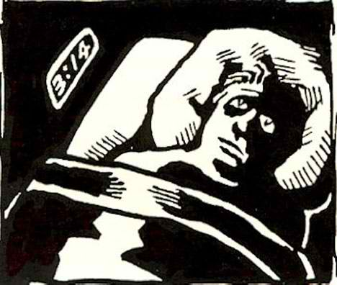
Setting Events
A temporarily distant event that may influence the likelihood that a challenging behaviour will occur
May occur in one environment and affect behaviour in another

Slide 17

Setting Events
Affects behaviour usually within 24 hours after they occur
Not an excuse to blame others
Consider using a setting events checklist

Slide 18
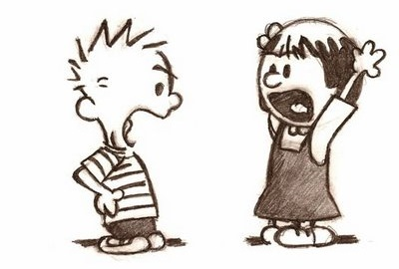
Setting Events
2 options for dealing with:
Change circumstances so that setting events no longer occur to influence the behaviour (proactive)
Provide supports to offset the impact the setting events (supportive)

Slide 19
The Assessment and Teaching Stages
A
Antecedent
Cue
B
Target Skill
Learner Response
C
Consequence
Feedback

Slide 20
A simplified way of framing the assessment and intervention process
Antecedent | Behaviour | Consequence
Proactive | Teach | Response
You!
You!

